Slide 1
Working with Canvas & SVG

Slide 2
Points to be discussed
Canvas
Working with audio
Working with video
Working with you tube

Slide 3
Canvas
HTML5 element <canvas> gives you an easy and powerful way to draw graphics using JavaScript.
It can be used to draw graphs, make photo compositions or do simple animations.

Slide 4
Rendering Context
The <canvas> is initially blank, and to display something, a script first needs to access the rendering context and draw on it.
The canvas element has a DOM method called getContext, used to obtain the rendering context and its drawing functions.
This function takes one parameter, the type of context2d.

Slide 5
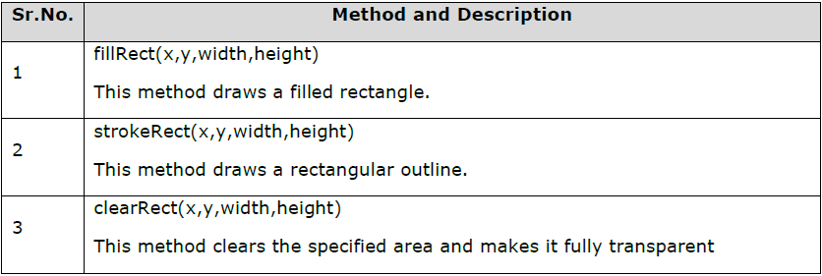
Creating Rectangle

Slide 6
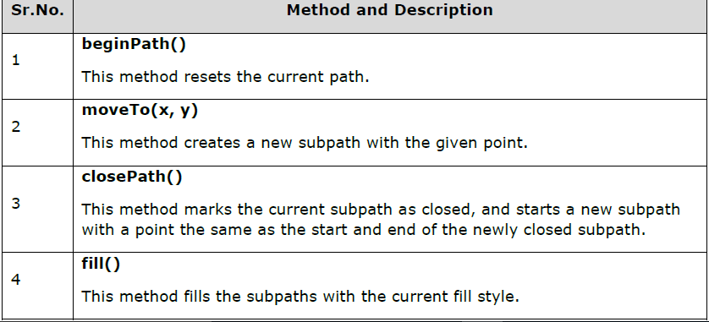
Drawing paths

Slide 7
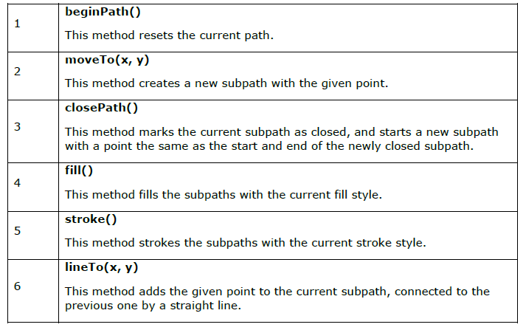
Drawing lines

Slide 8
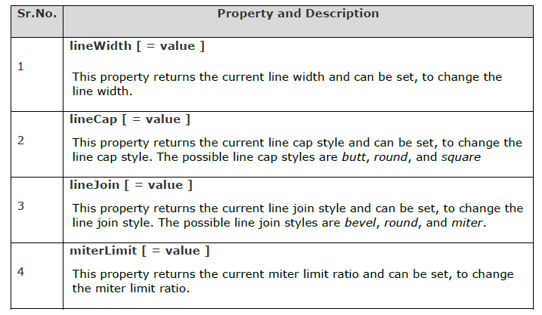
Line Properties

Slide 9
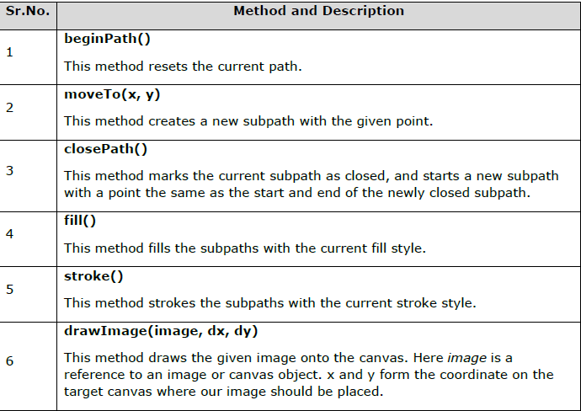
Working with images

Slide 10
Working with audio & video
The HTML5 <audio> and <video> tags make it simple to add media to a website.
You need to set src attribute to identify the media source and include a controls attribute so the user can play and pause the media

Slide 11
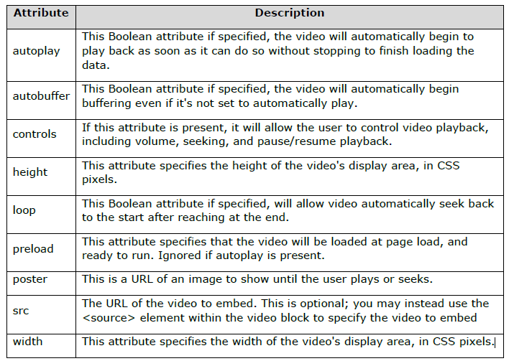
Video attribute specification

Slide 12
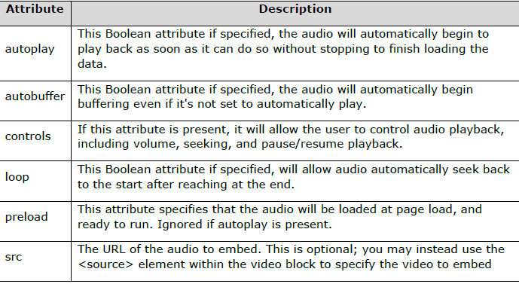
Audio Attribute Specification

Slide 13
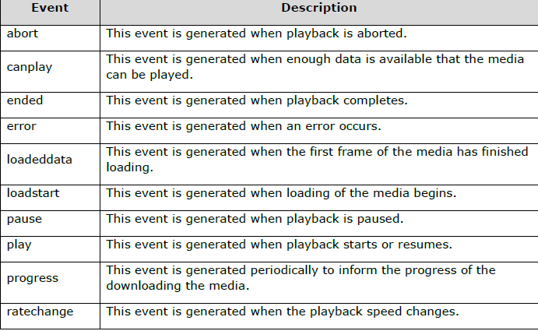
Media Events

Slide 14
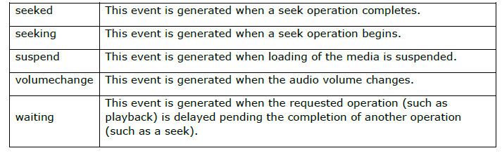
Cont…

Slide 15
<embed>
However the <embed> element is very well supported in current browsers and defined as standard in HTML5, but your audio might not played due to lack of browser support for that file format or unavailability of plugins.

Slide 16
<object>
The <object> element is not supported widely and very much depends on the type of the object that's being embedded.

